Slide 1
Becoming an Activated Patient – Part 1
Kenneth Brummel-Smith, MD
Charlotte Edwards Maguire Professor of Geriatrics
Florida State University College of Medicine

Slide 2
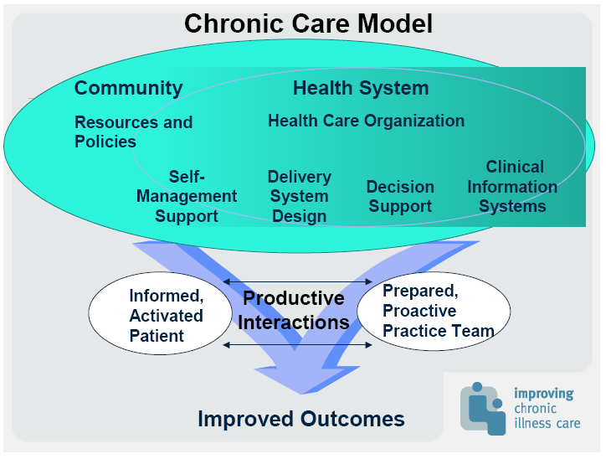

Slide 3
Definitions
Patient activation
  Understanding one’s own role in the care process and having the knowledge, skills, and confidence to take on that role.
Patient Engagement
  More active – acting on that knowledge
Patient-centered Care
  Care that is respectful of and responsive to individual patient preferences, needs, and values

Slide 4
Evidence Based Medicine
Best Research
Patient Values
Clinical Expertise

Slide 5
An “Extremist” Approach
Patients get exactly the help they want and need when they want and need it (Berwick)
Instead of hosting patients in our system, we are guests in their system
Every medical decision is based upon the principle of informed consent
No one knows best, for we all know differently.

Slide 6
Informed Consent
Doctors recommendation
  Benefits & harms
Alternatives to the recommendation
  Benefits & harms of those
What’s likely to happen if nothing is done
  Benefits & harms

Slide 7
Improving Activation
Various interventions studied
  Peer support
  Problem-solving skill training
  Chronic Disease Self-Management Training
Effective even those with multiple conditions, low socioeconomic status, and older patients
Greatest gains in those with low level of activation

Slide 8
Hibbard JH, Health Services Research, 2005; 40:1918-1930

Slide 9
Patient Activation Measure
13 items
Score 0-100
Based on patient beliefs, knowledge, and confidence in managing heath-related tasks
Four levels
  Level 1 – least activated
  Level 4 – most activated

Slide 10
Evidence of Patient Activation
Better health outcomes
Lower costs
Lower variation in care
More likely to participate in decision-making
Less likely to be hospitalized or use ER
Improved quality of care
Hibbard JH, Health Affairs 2013; 32:216-222

Slide 11
Types of Engagement
Direct clinical care
Organizational design and governance
Policy making

Slide 12
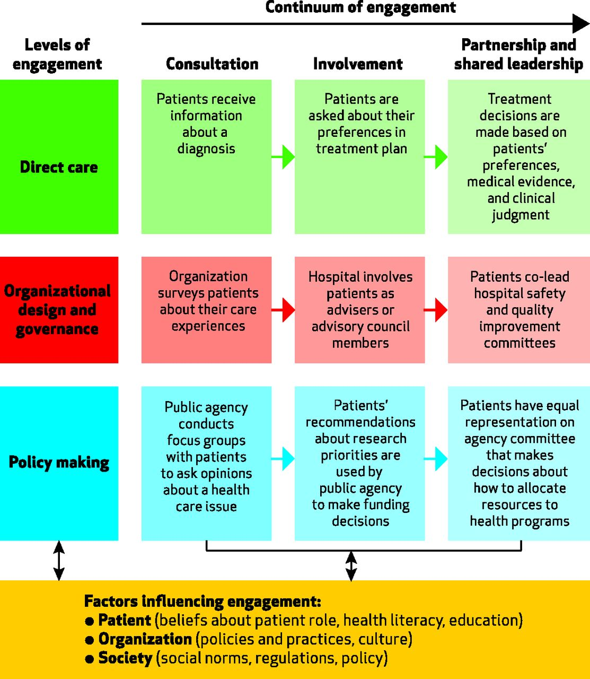
©2013 by Project HOPE - The People-to-People Health Foundation, Inc.
Carman K L et al. Health Aff 2013;32:223-231
Notes:
A Multidimensional Framework For Patient And Family Engagement In Health And Health Care

Slide 13
Example - EHR
Consultation
  You get print-out of lab tests
Involvement
  You get direct access to all records, but can’t add anything
Partnership
  You get direct access and can contribute – adding or correcting

Slide 14
Factors Affecting Engagement
Patients –
  Knowledge, attitudes, beliefs
  Experiences with the health care system
  Self-efficacy
  Functional abilities
  Literacy
  Cognitive problems

Slide 15
Factors Affecting Engagement
Organization
  Physician attitudes and beliefs
  Policies – open visiting, rounds at bedside, nurse shift change reports at bedside
  Patient access to medical records
  Provide support for caregivers
  Provide education in chronic disease management

Slide 16
Potential Examples
Informed consent for every intervention
No restrictions on hospital visiting
Patients decide what to wear and eat
Patients participate in the design of health care processes
Medical records belong to the patient
  And we have to get permission to view them
Shared-decision making technologies used
All patients trained in self-management skills

Slide 17
Changing Health Care
Measure patient-centeredness as a quality outcome
  “Is there anything at all that could have been done better today?
Vest control in the patient’s hands
Be transparent about science, costs, processes, and errors
  Apologize
“Customized standardization”
Train providers in emotional intelligence

